Slide 1
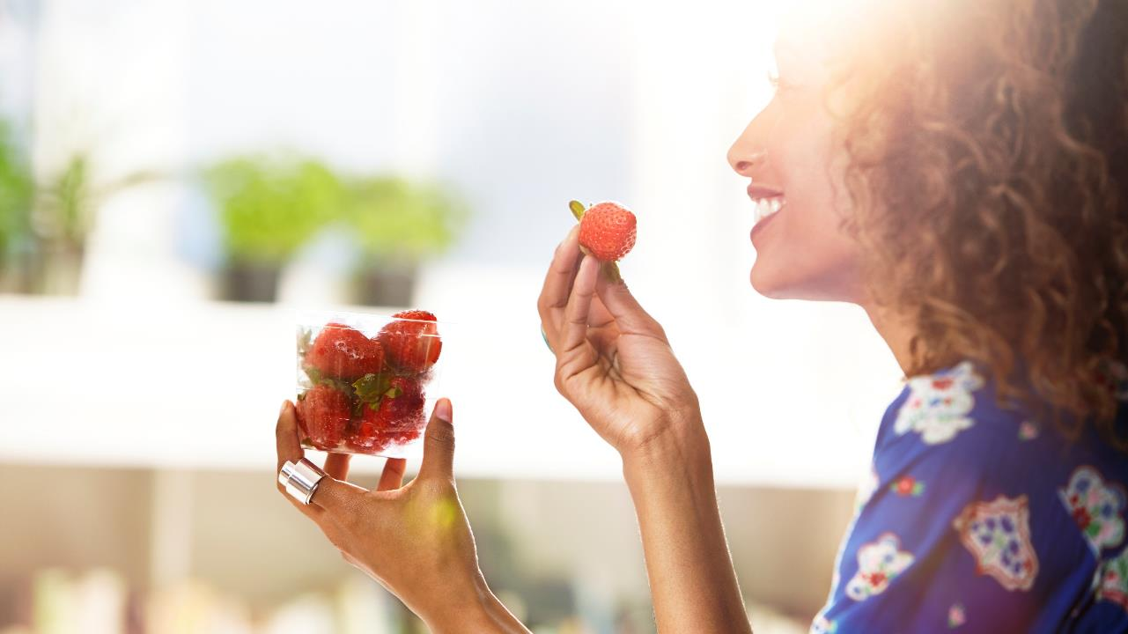

Better-for-you snacking: A cross-category perspective
Lauren Winkler
Renata de Moura
Kroger Workshop
April 2022

Slide 2
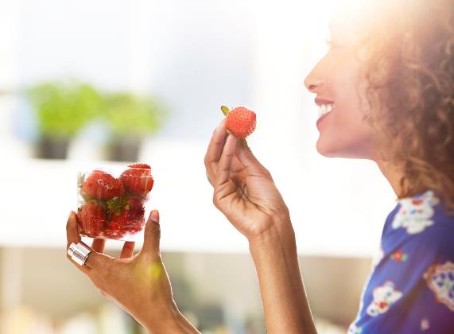
AGENDA
1 | Overview and methodology
2 | Better-for-you snacking in 2022
3 | The Kroger better-for-you shopper
4 | Merchandising better-for-you snacks
5 | Turning insights into actions

Slide 3
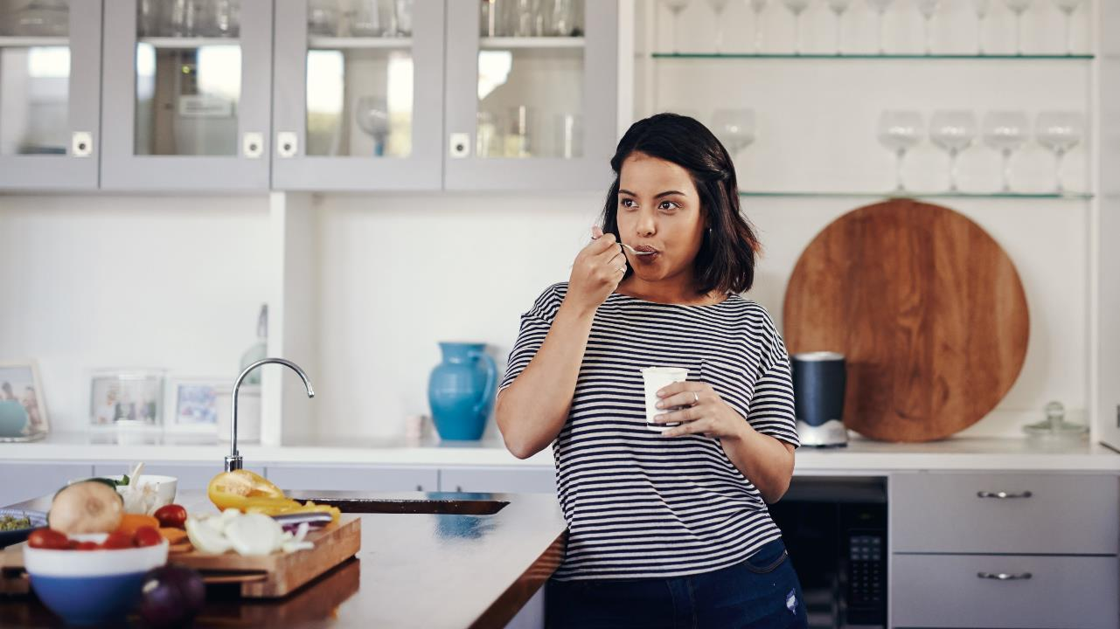
1
Overview and methodology

Slide 4
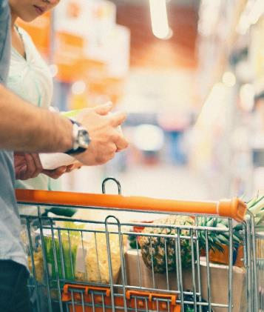
With a greater focus on maintaining good health, shoppers this year are spending more on better-for-you products
Top Types of Food Shoppers Are Spending More on Compared With Last Year
(share of shoppers who are spending more on types of food)

Slide 5
To better understand the better-for-you shopper, we conducted research this year on a wide range of better-for-you categories and retailers
Who
Fielding and topics
Respondent demos
N=1,000 shoppers
To qualify for the survey, respondents must be ages 18-65 and have purchased healthy snacks to snack on between meals.
Categories covered in this survey: popcorn, nut butters, dips, eggs, cheese puff and corn snacks, pork rinds, potato chips and tortilla chips, rice/popcorn cakes, cookies, dried meat snacks, cereal/granola bars/oatmeal, dark chocolates, crackers, fruits, smoothies and protein shakes, yogurt, refrigerated snack packs/plates, snack nuts and dried fruits, vegetables and beans fresh or dried, cheese, bread
Survey fielded online in February 2022
Topics included:
Importance of healthy attributes across categories​
Where and how shoppers are purchasing healthy snacks, their motivations, and opportunities to improve the shopping experience
Impact of COVID on healthy snacking
Female | 52%
Male | 48%
Gen Z (19-25) | 6%
Emerging millennials (26-33) | 20%
Adult millennials (34-43) | 20%
Gen X (44-57) | 30%
Boomers (58-76) | 26%
<$50K | 32%
$50K-$99.9K | 31%
$100K+ | 37%

Slide 6
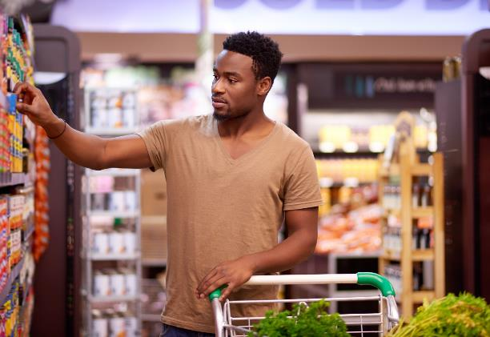
The pandemic has made shoppers prioritize their health, boosting healthy snacks purchases
Changes in Healthy Snack Purchasing Habits During the Pandemic
(among shoppers who purchase healthy snacks)
Who Is Purchasing More Healthy Snacks?
56%
Emerging millennials
51%
Above $100K
59%
Urban residents
Sig. > vs. all shoppers (95% confidence level)

Slide 7
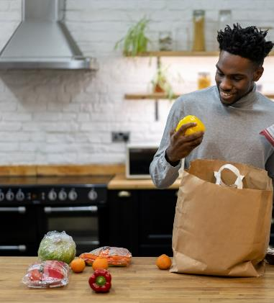
Healthy snacking tops the list of behaviors continuing post-pandemic, with a significant demand from Gen X
Behaviors Started With Pandemic, but Will Likely Continue
(among shoppers who purchase healthy snacks)
Gen X
36%
Buying healthier snacks
Black/African American
25%
Buying snacks that help boost my immune system
Sig. > vs. all shoppers (95% confidence level)

Slide 8
More conscious about their health, Gen X and boomers are replacing unhealthy snacks with healthy options
Reasons to Purchase More Healthy Snacks During the Pandemic
(among shoppers who are purchasing more healthy snacks)
I have been purchasing healthier snacks for my kids since they are more often at home
42%
Adult millennials
40%
>$100K
I am more conscious of my health and am replacing unhealthy snacks with healthier options
74%
Gen X
79%
Boomers

Slide 9
Who are the most frequent buyers of better-for-you snack? Top targets are millennials, high-income earners, and urban shoppers
Snacking Preferences
(among shoppers who purchase healthy snacks)
Millennials
Higher Income
Urban
Of always healthy snackers are millennials
Of always healthy snackers earn $100K+
Of always healthy snackers live in urban areas

Slide 10
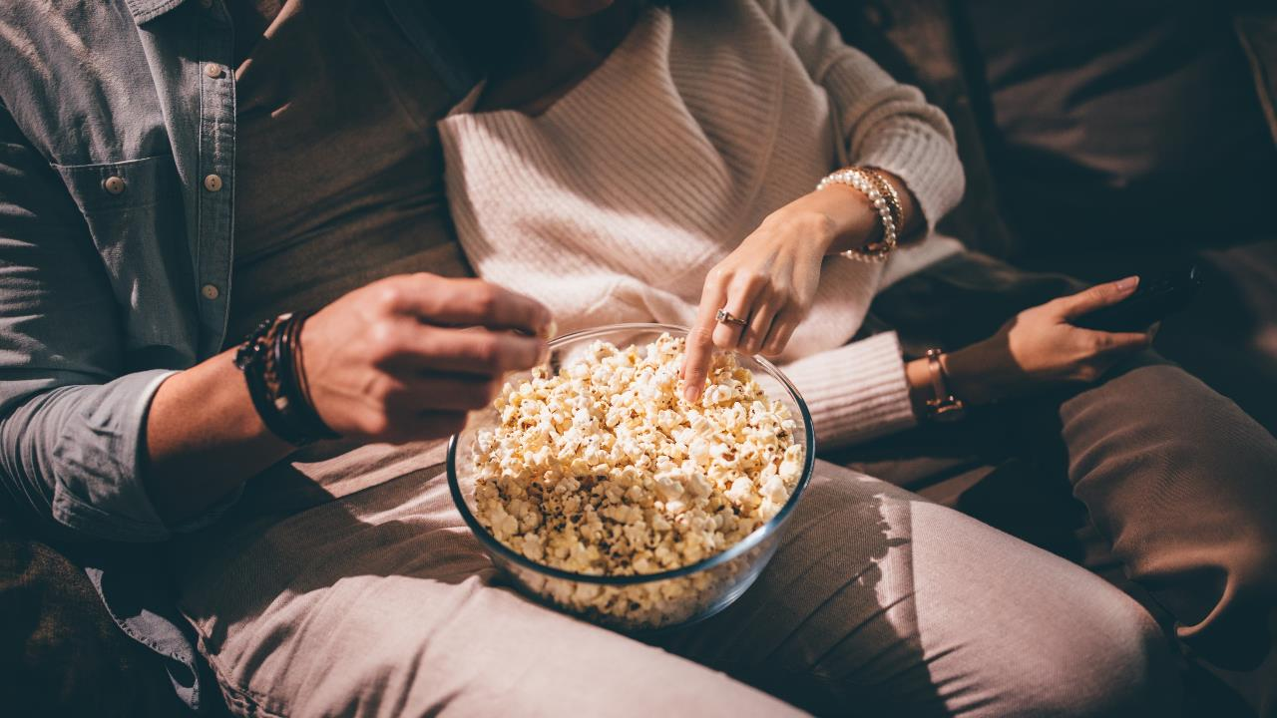
2
Better-for-you snacking in 2022

Slide 11
The top better-for-you snack categories are not typically categorized as snacks within traditional category management: fruit, bread, vegetables, and eggs
Most Frequently Purchased Foods to Snack on Between Meals
(among shoppers who purchase healthy snacks)

Slide 12
More traditional snack categories such as pork rinds, popcorn, and rice cakes need to work harder to be more frequently purchased as healthy snacks
Least Frequently Purchased Foods to Snack on Between Meals
(among shoppers who purchase healthy snacks)

Slide 13
While shoppers buy eggs and nuts/dried fruits for the protein, they buy vegetables/beans and crackers to satisfy hunger
Reason for Purchasing Foods to Snack on Between Meals by Subcategory
(among shoppers who purchase healthy snacks)
Fruits | Eggs | Vegetables/beans dried or fresh | Potato/tortilla chips
Yogurt | Snack nuts/dried fruits | Crackers | Cheese
All natural ingredients
46%
High protein
44%
Fill me up/stave off hunger
41%
Enjoy as a treat/indulgence
54%
Fill me up/stave off hunger
40%
Fill me up/stave off hunger
32%
All natural ingredients
38%
Fill me up/stave off hunger
32%
Heart healthy
35%
All natural ingredients
26%
Heart healthy
33%
Consume on the go
28%
Gut-friendly
37%
High protein
43%
Fill me up/stave off hunger
39%
Enjoy as a treat/indulgence
39%
Fill me up/stave off hunger
36%
Enjoy as a treat/indulgence
39%
Enjoy as a treat/indulgence
39%
Fill me up/stave off hunger
33%
Enjoy as a treat/indulgence
34%
Heart healthy
36%
Whole grain/multigrain
27%
Consume on the go
29%

Slide 14

Shoppers want ‘high’ snacks more than ‘low’ snacks: High vitamins/minerals and high protein are more appealing than low sugar, low calories, or low carbs
Attributes Considered Very Important to Shoppers When Choosing Healthy Snacks
(among shoppers who purchase healthy snacks)

Slide 15
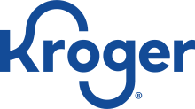



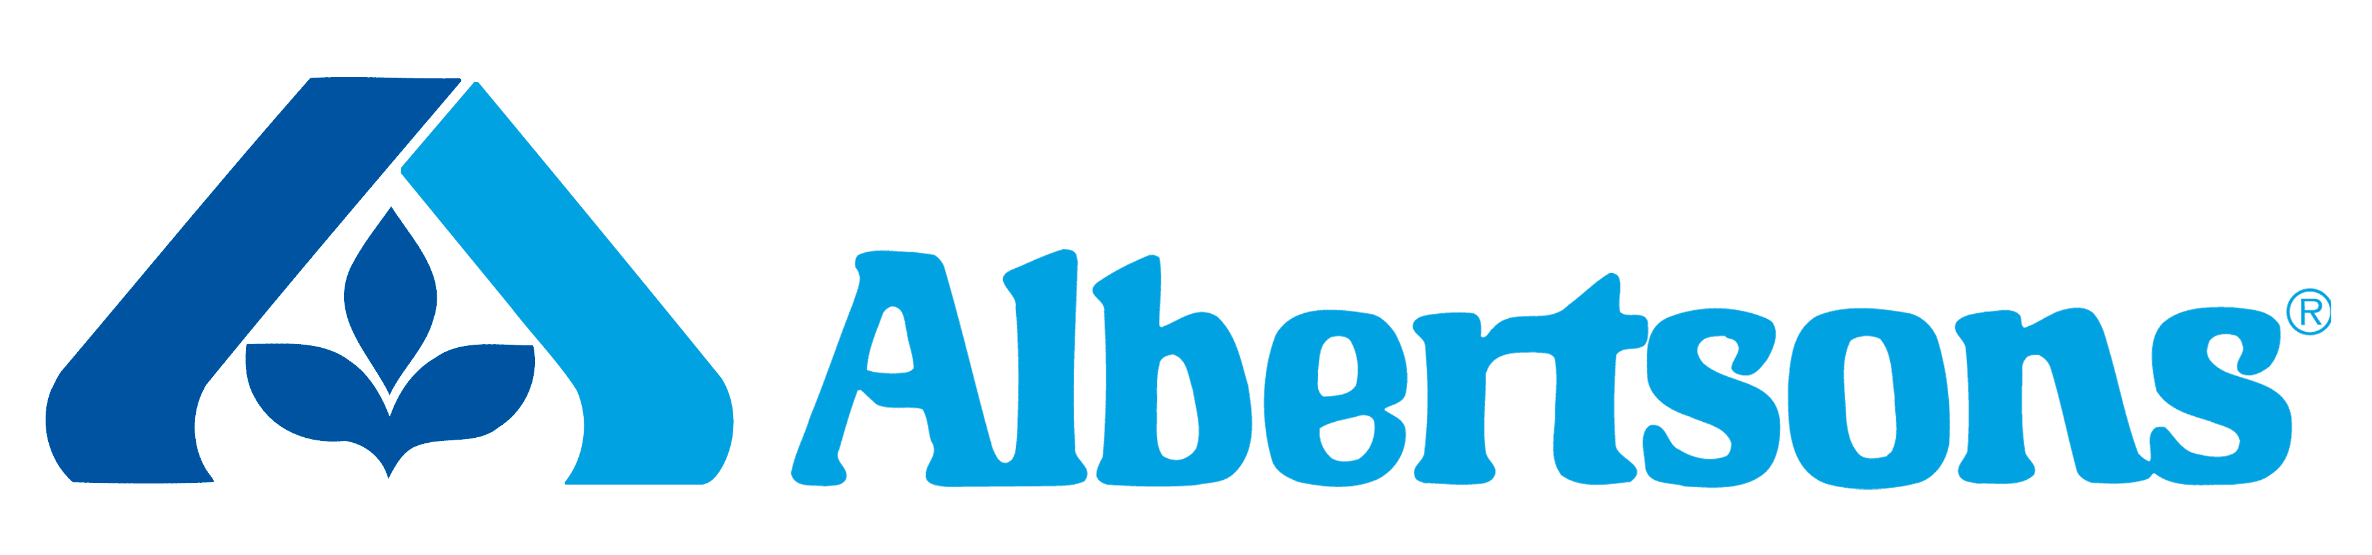

While Walmart is the destination for most healthy snack shoppers (likely driven by lower prices), millennials are highly likely to shop at Kroger
Top Retailers Shopped for Healthy Snacks in the Past Month and by Generation
(among shoppers who purchase healthy snacks)
 | Gen Z | Emerging millennials | Adult millennials | Gen X | Boomers
 | 64% | 69% | 69% | 72% | 59%
 | 50% | 57% | 52% | 36% | 34%
 | 48% | 52% | 53% | 38% | 28%
 | 47% | 50% | 47% | 38% | 26%
 | 31% | 44% | 48% | 38% | 25%
 | 33% | 41% | 32% | 27% | 23%
 | 33% | 36% | 31% | 32% | 22%
 | 36% | 35% | 24% | 27% | 20%
 | 29% | 37% | 27% | 25% | 18%
 | 31% | 36% | 32% | 21% | 20%
 | 19% | 23% | 21% | 25% | 24%
Note: Walmart does not include Walmart Neighborhood Market. Kroger Includes Dillons, Fry’s, Harris Teeter, King Soopers, Kroger, Mariano’s, Pick ‘n Save, QFC, Ralphs, and Smith’s banners.
Sig. > vs. all shoppers (95% confidence level)
Sig. < vs. all shoppers (95% confidence level)

Slide 16

Among shoppers who always purchase better-for-you snacks, Kroger now ties Walmart
Top Retailers Shopped for Snacks in the Past Month
(among shoppers who always purchase snacks they consider to be healthy)
I always purchase snacks that I consider to be healthy
Note: Walmart does not include Walmart Neighborhood Market. Kroger Includes Dillons, Fry’s, Harris Teeter, King Soopers, Kroger, Mariano’s, Pick ‘n Save, QFC, Ralphs, and Smith’s banners.

Slide 17
3
The Kroger
better-for-you
shopper

Slide 18


Who is the Kroger better-for-you shopper? Emerging millennials, but Kroger specifically attracts African American and male better-for-you shoppers
Emerging Millennials
Men
African American
Kroger
25%
Kroger
51%
Kroger
20%
All shoppers
20%
All shoppers
48%
All shoppers
14%

Slide 19
Kroger shoppers snack more frequently and more often choose healthy snacks
Snacking Frequency
Healthy vs. Unhealthy Snacks
(among shoppers who purchase healthy snacks)
(among shoppers who purchase healthy snacks)
All shoppers
Kroger
All shoppers
Kroger

Slide 20
Kroger better-for-you snacks are similar to those at other retailers, but Kroger shoppers add cheese and crackers to their better-for-you shopping list
Most Frequently Purchased Foods to Snack on Between Meals
(among shoppers who purchase healthy snacks)
Total top snack foods for all shoppers:
Fruit
Bread
Vegetables/ beans
Eggs
Potato chips
Cereal
Yogurt
Snack nuts
Total top snack foods for Kroger shoppers:
v
v
Fruit
Bread
Vegetables/ beans
Eggs
Potato
chips
Cheese
Yogurt
Crackers

Slide 21
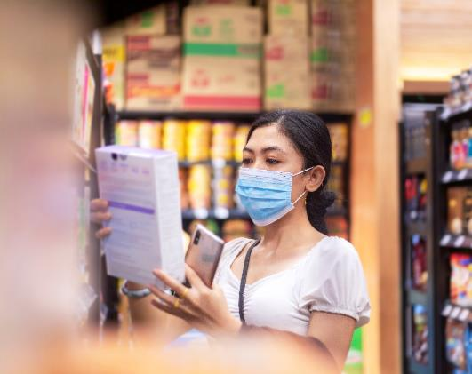
Kroger snackers are more likely to turn to reviews and recommendations to determine what is ‘better for you’
How Shoppers Decide Which Products Are Healthy
(among shoppers who purchase healthy snacks)

Slide 22
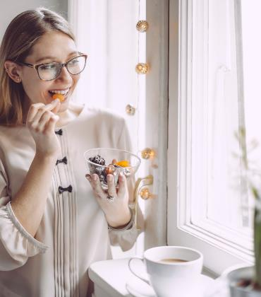
Splurging usually means switching categories, but Kroger shoppers will premiumize within better-for-you snacks
Meaning of “Splurging” on Snacks for Frequent Snackers
(among shoppers who purchase healthy snacks and report being frequent snackers)
Sig. > vs. all shoppers (95% confidence level)

Slide 23
Kroger shoppers struggle more than other retail shoppers to find better-for-you snacks
Kroger shoppers have more trouble finding better-for-you snacks
Healthy snacks brands are often hard to find:
All shoppers
44%
Kroger shoppers
47%
On-the-go options of healthy snacks are hard to find:
All shoppers
39%
Kroger shoppers
43%

Slide 24
Kroger shoppers are more wary of claims, especially from large manufacturers
Kroger shoppers have more trouble finding better-for-you snacks
Kroger shoppers are less trusting of better-for-you health claims
Healthy snacks brands are often hard to find:
It is hard to trust the health benefits of healthy snacks:
All shoppers
44%
Kroger shoppers
47%
All shoppers
39%
Kroger shoppers
43%
On-the-go options of healthy snacks are hard to find:
It is hard to trust the health benefits of larger manufacturers:
All shoppers
39%
Kroger shoppers
43%
All shoppers
41%
Kroger shoppers
47%

Slide 25
Private label represents an opportunity for innovation and freshness
Kroger shoppers have more trouble finding better-for-you snacks
Kroger shoppers are less trusting of better-for-you health claims
Private label is an opportunity to meet Kroger shoppers’ BFY needs
Healthy snacks brands are often hard to find:
It is hard to trust the health benefits of healthy snacks:
I prefer store brand snacks because they are fresher:
All shoppers
44%
Kroger shoppers
47%
All shoppers
39%
Kroger shoppers
43%
All shoppers
33%
Kroger shoppers
43%
Store brand healthy snacks lag behind in innovation:
On-the-go options of healthy snacks are hard to find:
It is hard to trust the health benefits of larger manufacturers:
All shoppers
36%
Kroger shoppers
41%
All shoppers
39%
Kroger shoppers
43%
All shoppers
41%
Kroger shoppers
47%
Healthy snacks do not taste as good as regular snacks:
All shoppers
38%
Kroger shoppers
47%

Slide 26
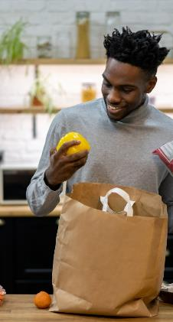

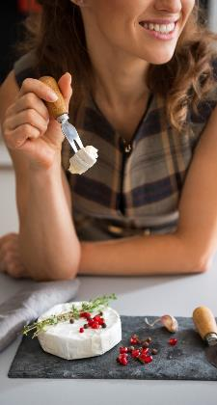
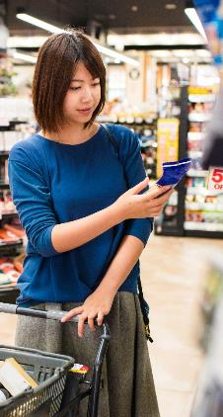

Five things to remember about the Kroger better-for-you shopper
Younger, more men and African- Americans
More frequent, healthier snackers
Include cheese as better-for-you snack
Struggle to find and trust better-for-you snacks
Open to innovations in private label

Slide 27
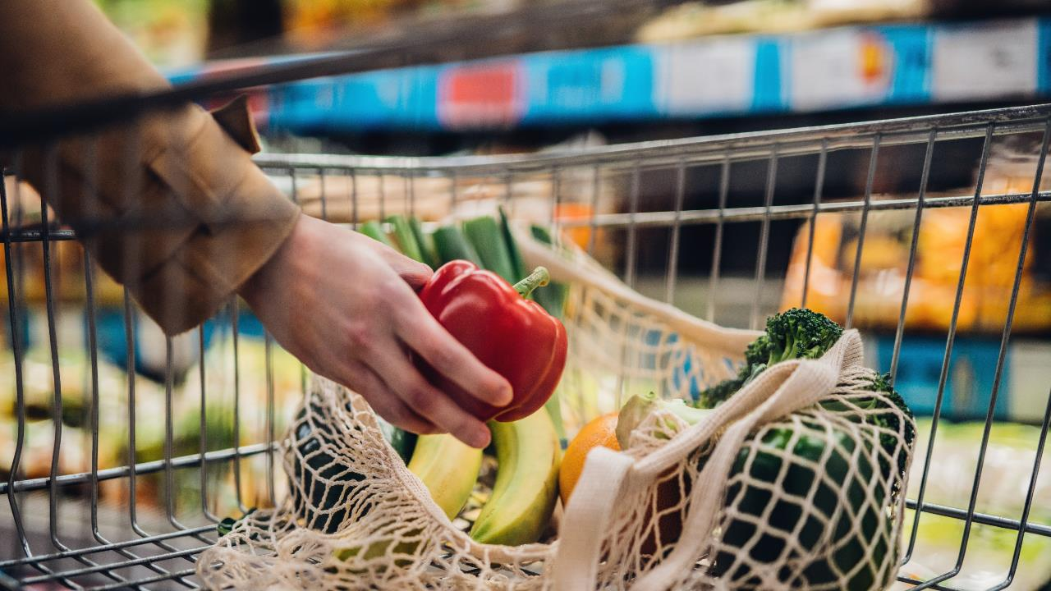
4
Merchandising better-for-you snacks

Slide 28
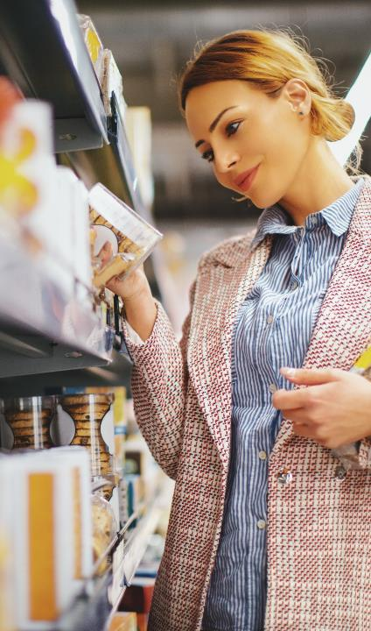

Kroger ranks among the top healthy snack retailers, falling just behind specialized health food stores like Trader Joe’s and Whole Foods Market
Ranking of Top 3 Stores to Shop for Healthy Snacks
(among shoppers who purchase healthy snacks)

Slide 29

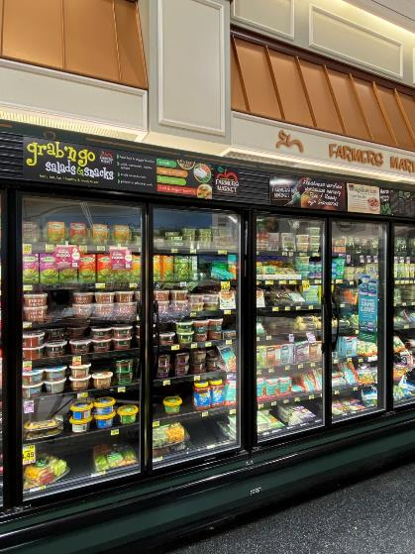
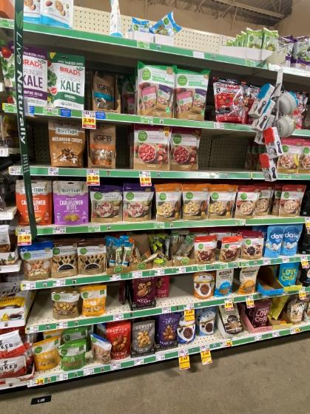
Kroger uses farmers market messaging, vegetable ingredients as better-for-you indicators

Slide 30
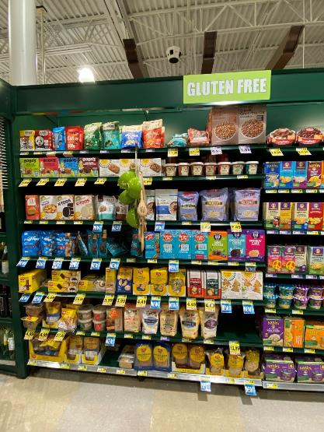
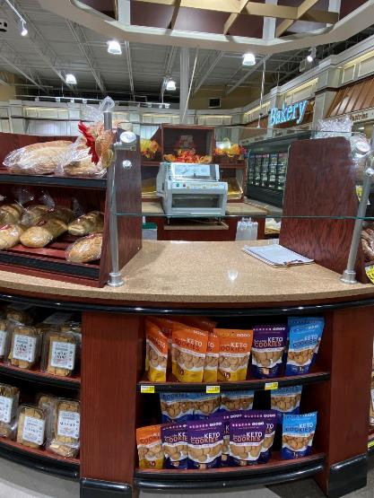
Diet messaging implies health
Keto cookies

Slide 31
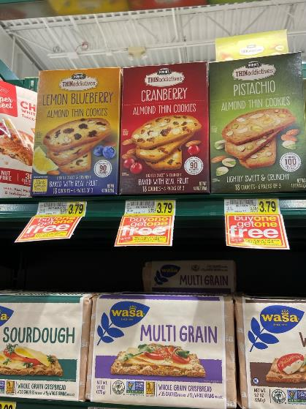
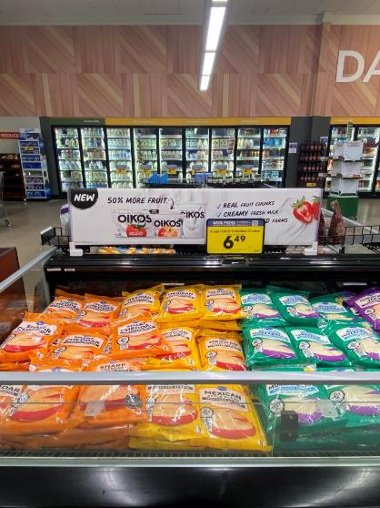
Better-for-you foods focus on inclusion of ingredients
Thin cookies
50% more fruit

Slide 32
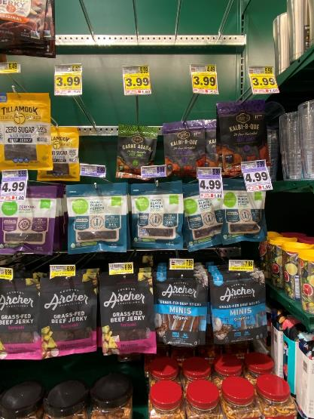
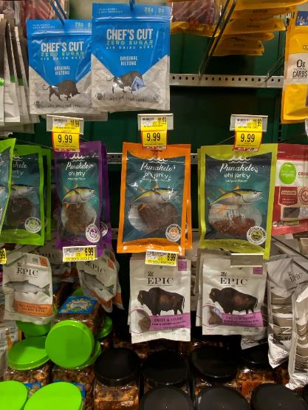
Less healthy snacks leverage particular phrases for a healthy halo
Grass-fed
Chef’s cut, zero sugar

Slide 33
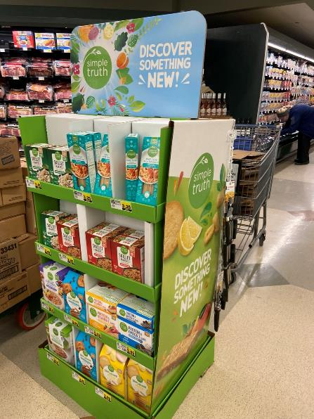
Private label messaging focuses on innovation and discovery to attract eyeballs in store

Slide 34


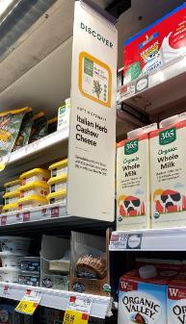
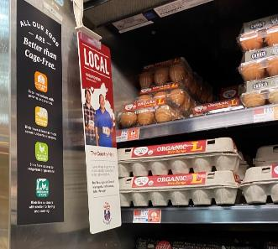
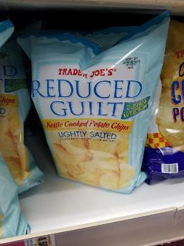
The variety of product/claim innovations at Whole Foods and Trader Joe’s appeals to healthy snackers, likely making these retailers the best-rated stores
Cashew cheese and locally sourced eggs
Reduced Guilt potato chips

Slide 35
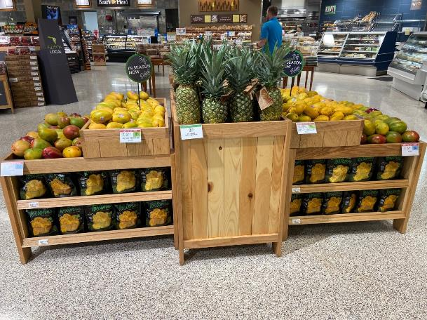
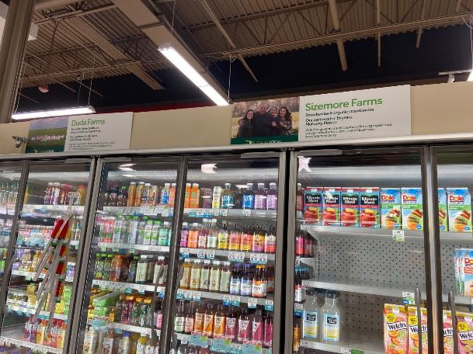
Similar to Kroger, Publix leverages farming and ‘in season’ language to convey health

Slide 36
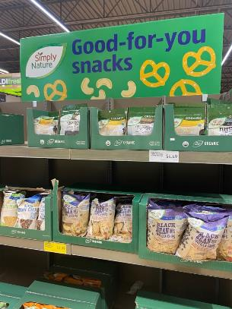
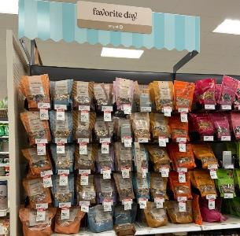
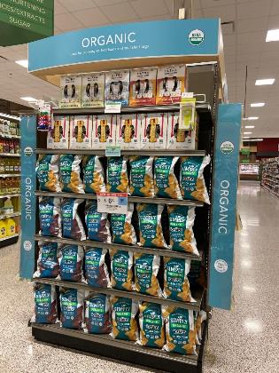


Aldi, Target, and Publix have a broad selection of better-for-you private label items

Slide 37
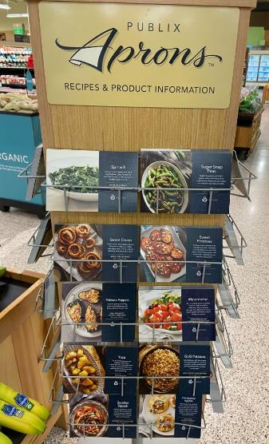
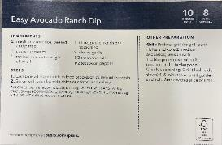
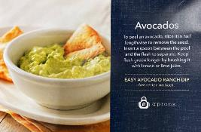
Cards showing recipes of simple, fresh and yet indulgent snacks can appeal to shoppers who want to eat fruits and vegetables as snacks
In Publix stores, Aprons recipes are available for quick/easy meals to stimulate healthy eating. A similar initiative could also be available for healthy snacks like dips and vegetable chips.

Slide 38
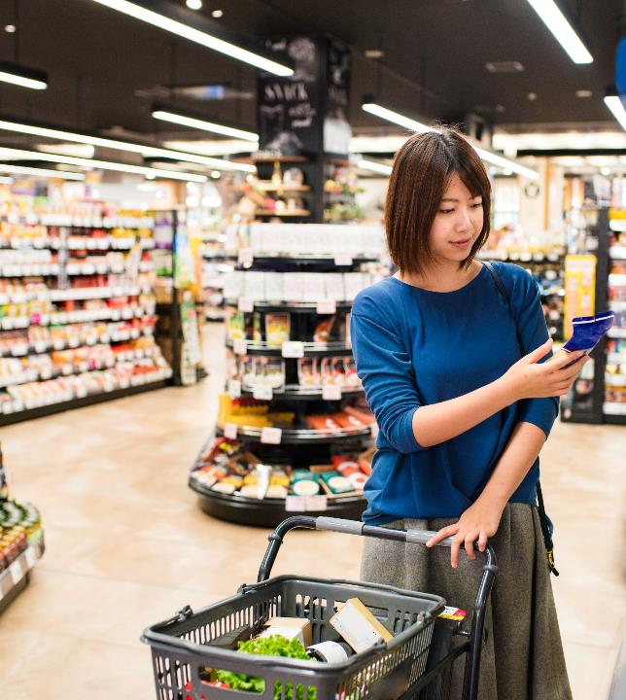
Lower-priced options as well as items with more vitamins/mineral and low sugar/sodium are among the top suggestions to improve the shopping experience
Top Suggestions to Improve Shopping Experience for Healthy Snacks
(among shoppers who purchase healthy snacks)

Slide 39

5
Turning insights
into actions

Slide 40

Turning insights into actions
Supplier implications
Retailer implications
Better-for-you “snacking” does not need to live within the traditional snack categories — any and every category should consider how it can play in this space. In particular, consider on-the-go options as away-from-home routines continue to expand.
Know your retailers and their better-for-you shoppers, including the right mix of categories and health attributes that will appeal differently across channels.
Packaging plays a crucial role in projecting better-for-you qualities. Understand the health attributes important in your category and the main role that your category plays in shoppers’ snacking needs to tailor packaging claims.
Know your better-for-you snackers and shoppers. Understanding who the better-for-you snackers are at your store and how they assess which categories and products are better for them is crucial to correctly merchandising these categories.
Merchandising better-for-you snacks — both the selection of brands/products and the messaging at shelf — is a large component of how shoppers assess health status.
Private label represents an opportunity to bring freshness and innovation into the better-for-you snacking category.

Slide 41

THANK YOU
For further information please refer to retailiq.kantar.com
Contact:
Lauren Winkler
Vice President, Category Insights
lauren.winkler@kantar.com
Contact:
Renata de Moura
Senior Director, Shopper Insights
renata.demoura@kantar.com

